Slide 1
Classifying 100 Images on CIFAR-Dataset
Nathanael Solagratia & Christian Simmons

Slide 2
Introduction
Deep Neural Networks (DNNs) excel at complex tasks like image classification or recognition, where traditional machine learning (ML) reaches its limits.
Introduced in 2009, the CIFAR-100 dataset remains a fundamental benchmark for evaluating fine-grained image recognition. The goal is to classify 100 distinct images, with only 32x32 pixel resolution.
We chose this task because it clearly demonstrates how DNNs outperform classical ML as dataset size and class count scales larger and bigger.

Slide 3
Data Preparation
The entire CIFAR-100 dataset consists of 60K images, and we split the dataset into 40K training, 10K validation and testing (Krizhevsky & Hinton, 2009).
Entire dataset transferred to GPU memory for zero data-transfer latency. Real-time training augmentations (random cropping & horizontal flipping) executed directly on the GPU.

Slide 4
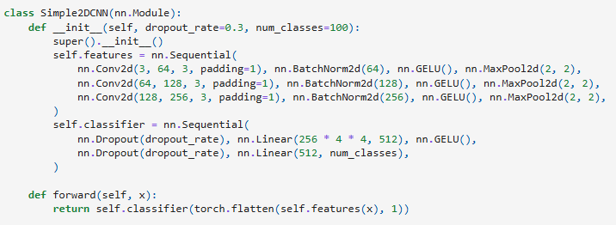
2D-CNN Model Description
Feedforward 2D CNN with Gaussian Error Linear Unit (GELU) activation. The model expect 32x32 input dimension.
It has 3 layers, each has 3x3 convolution, batch normalization, GELU activation, and 2x2 max pooling layer.
We utilized drop out rate of 30% and 512-unit hidden layer.

Slide 5
Logistic Regression Model

Slide 6
References
Dosovitskiy, A. (2020). An image is worth 16x16 words: Transformers for image recognition at scale. arXiv preprint arXiv:2010.11929.
Krizhevsky, A., & Hinton, G. (2009). Learning multiple layers of features from tiny images.
Lin, M., Chen, Q., & Yan, S. (2013). Network in network. arXiv preprint arXiv:1312.4400.

